Slide 1
A Turn-Taking Based Number Guessing Game
Meral Kuyucu
İlknur Çelik

Slide 2
Preliminaries

Slide 3
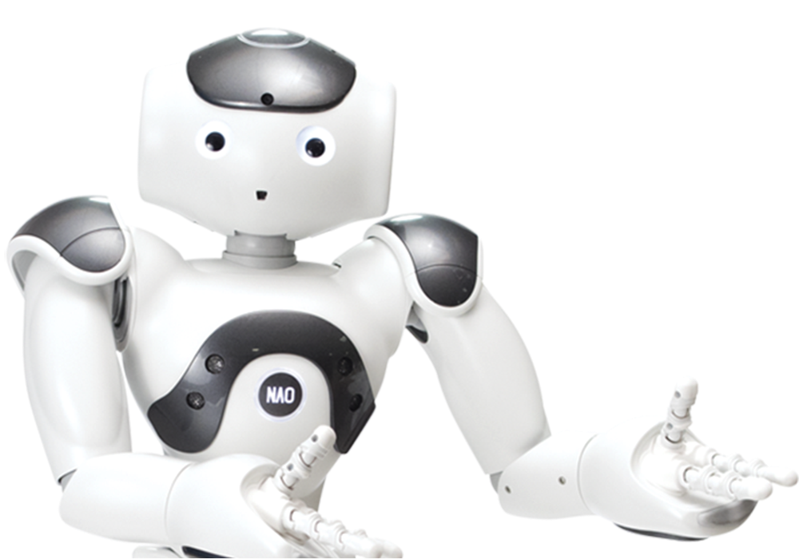
INTRODUCTION
“Guess the Number” is a human-robot interactive game designed to support the development of mathematical abilities of children in the developmental age.
Humanoid NAO Robot
Turn-Taking
Physical and Verbal Communication

Slide 4



TECHNOLOGIES
Python
Webots Simulator
Google Speech API
Socket Programming
Choregraphe

Slide 5

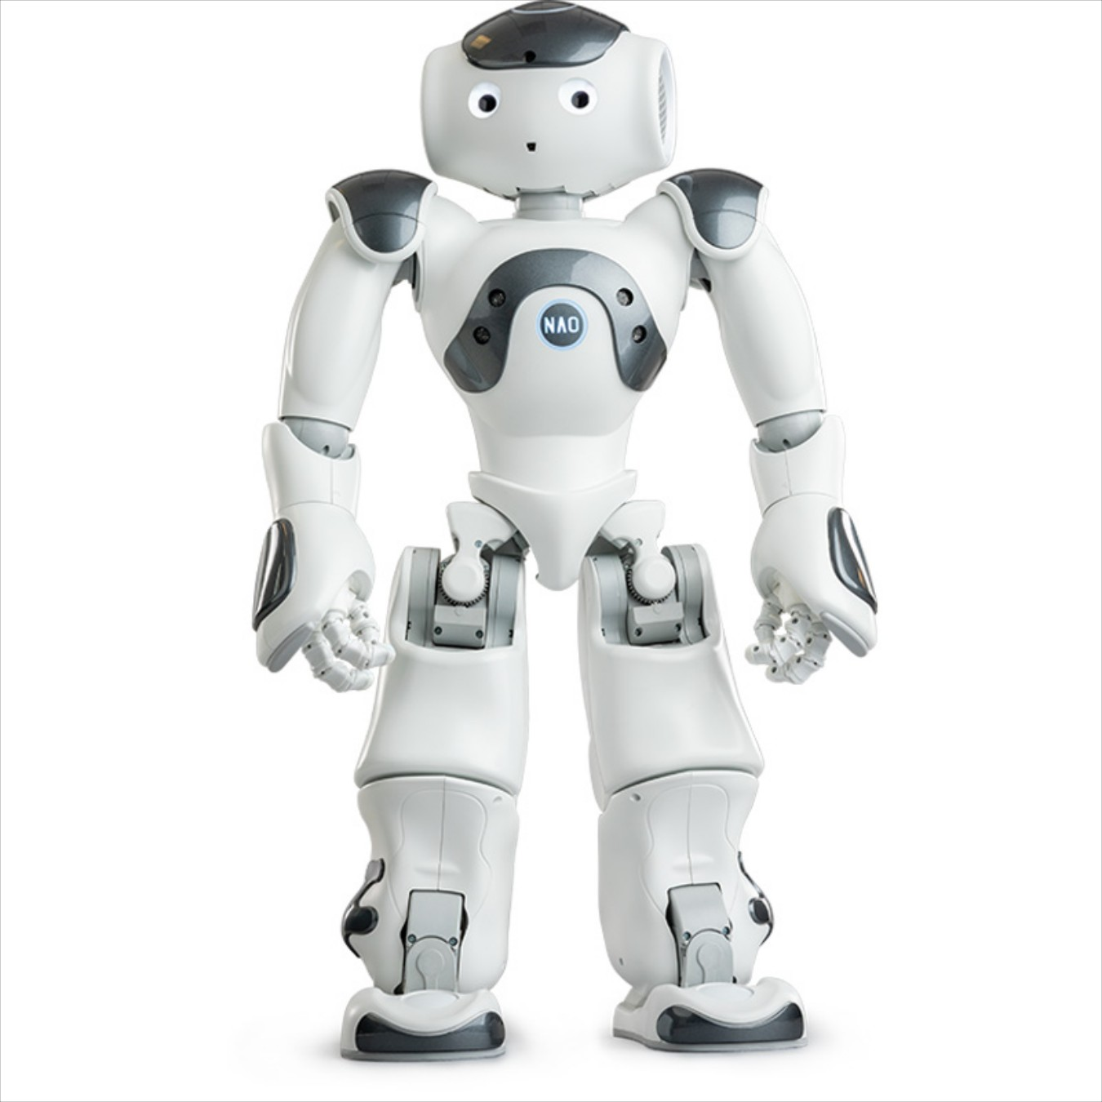
GAME LOOP
Choregraphe
Speech Solutions Server
Motion files
Voice Input
Comparison Mechanism
Guess > Goal
Down
Guess < Goal
Up
Guess = Goal
Dance
Goal: Random Number

Slide 6
Implementation

Slide 7

Incorporation of Speech
Lack of Webots Speech Support
Proposed Solution: Speech Processing in the Cloud
Google Speech API
Connect to Common Host
Speech to Text
Text to Speech

Slide 8
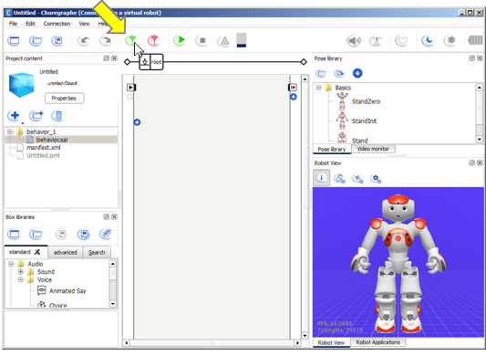
Preparing and Interfacing the Motions
Motion Extraction via Choregraphe
Record Joint Angles at Timestamps
Manual Manipulation of Robot Joints
Export Python File
Times
Names
Keys
Webots Motion Files Extracted From Choregraphe Python File
Motions Performed in Webots Simulator

Slide 9
DEMO

Slide 10


Slide 11
Evaluation and Discussion

Slide 12
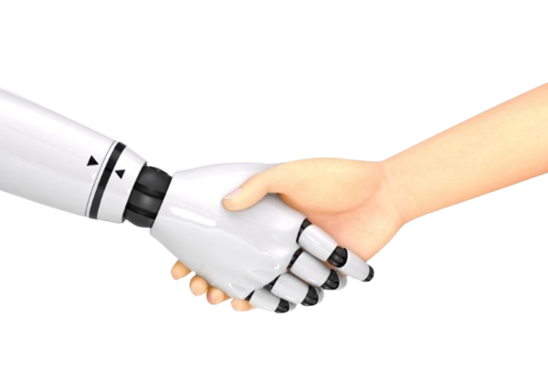
Evaluation in Terms of HRI
Physical Proximity: Proximate Colocated
Structure of Group: Human-Robot Individual Interaction
Nature of Task: Social Oriented / Edutainment Task
Duration of Interaction: Repeated Relatively Long Interaction
Information Exchange: Speech & Gestures
Motivation for Interaction: Spontaneous
Autonomy Level: Peer-to-Peer Collaboration
Embodiment: Anthropomorphic
Affordances: Moving, Socializing

Slide 13

Challenges
Simulator
Operating System
No Software Support for M1 Machines
Speech Recognition
Busy Waiting
Motion Detection
Translation of Choregraphe Motion files to Webots Motion Files

Slide 14

Future Work
Implementation Outside of Simulator
Fool-Proof Speech Recognition
Non-Numerical Inputs
More Forms of Interaction
Visual - Finger
Visual - Written Inputs
Switching Roles in Gameplay
Robot Guesses

Slide 15
Conclusions
Peer-to-Peer Guess the Number Game w/ NAO Robot
Supports Mathematical Abilities of Children
Supports Social Skills of Children (Turn-Taking)
Implemented w/ Python, Webots, and Choregraphe

Slide 16
THANK YOU FOR LISTENING!

